Slide 1
Food and Beverage Management fifth edition
Chapter 7
Food and Beverage Service

Slide 2
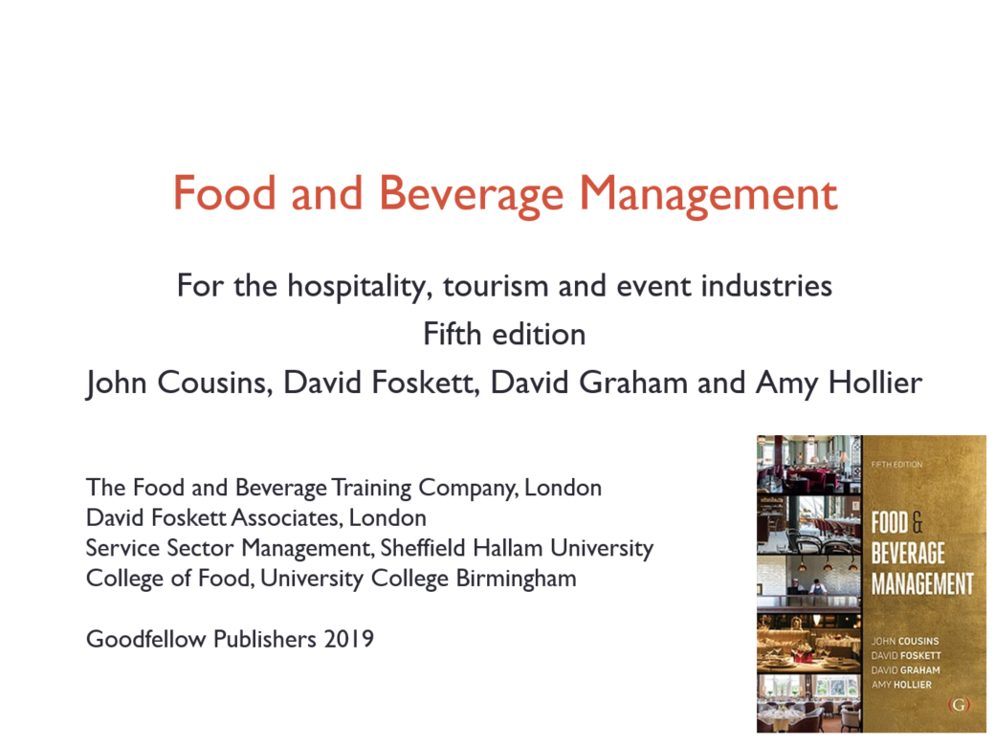

Slide 3
Chapter 7 covers:
The nature of food and beverage service
Food and beverage service systems
Customer service vs resource productivity
Customer relations
Managing volume
Managing the service sequence
Revenue control

Slide 4
Key requirements for staff
Sound product knowledge
Well developed interpersonal skills
A range of technical skills
An ability to work as part of a team

Slide 5
Food and beverage service
Consists of two separate sub-systems operating at the same time
The service sequence
Delivery of the food and beverages to the customer
The customer process
The experience the customer undertakes

Slide 6
The service sequence
Eleven or more stages:
Preparation for service
Taking bookings
Greeting, seating/directing
Taking food and beverage orders
Serving of food
Serving beverages
Clearing during service
Billing
Dealing with payments
Dishwashing
Clearing following service

Slide 7
The customer process
The customer is required to undertake or observe certain requirements
For example:
Enterers the food service area
Orders or selects choice
Served (may pay either at this point or later)
Food and beverages are then consumed, customer leaves and area is cleared

Slide 8
Categorising service methods
From a customer process perspective, five basic types of customer process can be identified

Slide 9
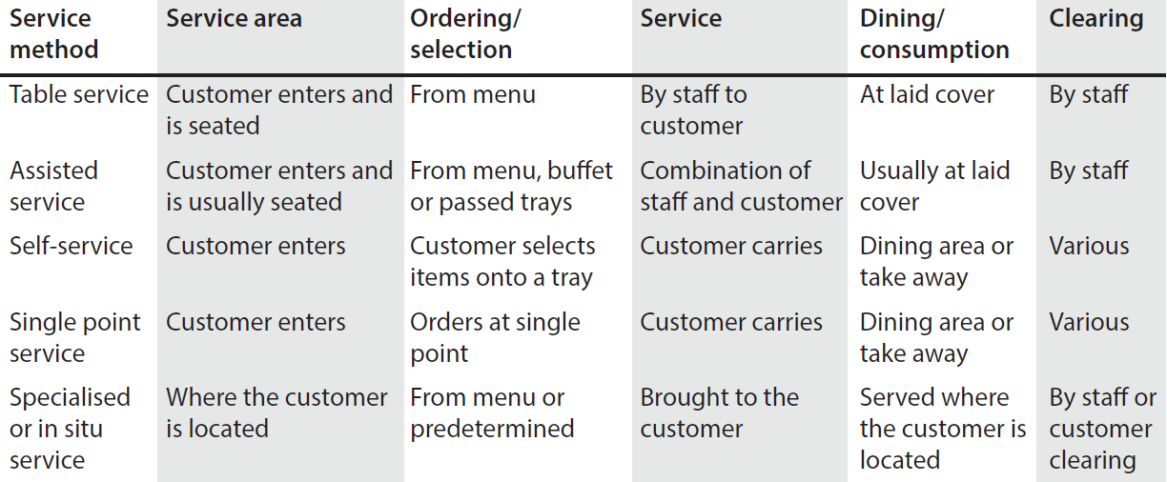
Five basic customer processes

Slide 10
The five service method groups
Table service - service at a laid table, e.g. plated service, silver service, guéridon service
Assisted service - part service at a laid cover and part self-service
Self-service - from a buffet or counter
Single point service - ordering, receipt of order and payment at the same time
Specialised service (or service in-situ) - the food and drink is taken to where the customer is located

Slide 11
Changing service methods
In groups A to D the customer process is similar for each of the service methods within the same group
Changing between service methods in the same group does not fundamentally alter the customer process
Changing service methods between groups alters the customer process
Group E has a specialised set of requirements

Slide 12
Providing customer service
Combination of five characteristics:
Service level
Service availability
Level of standards
Service reliability
Service flexibility
The ‘customer service specification’ must take account of all of these

Slide 13
Level of service : standards of service
Level of service
From very limited to very complex with high levels of personal attention
Standards of service
Measure of how well the operation delivers the level of service it is offering

Slide 14
Ensuring customer service
Written statements of both:
Technical specification
physical characteristics of the products
Service specification
procedures and the way they are carried out
Often called a ‘customer service specification’
Need for balance between maintaining customer service and resource productivity

Slide 15
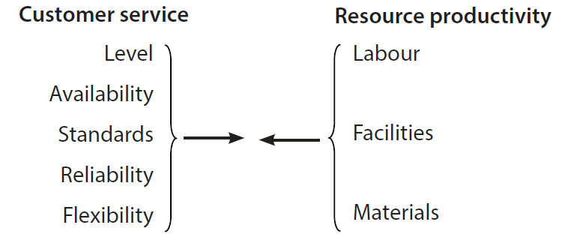
Customer service vs resource productivity

Slide 16
Maintain good interpersonal relationships
Between service staff and the customer (external customers)
Between service staff an other departments (internal customers)

Slide 17
Maintaining good customer relations
Requires the ability to:
Recognise the symptoms of a deterioration in customer relations
Minimise the causes of customer relations problems

Slide 18
Symptoms of poor customer relations
Increases in number of complaints generally and especially about staff
Increases in number of accidents
Regular mistakes by staff
Customers arriving without previous bookings
Increases in breakages
Shortages of equipment
Arguments between staff
Poor morale and high turnover of staff

Slide 19
Important to ensure:
Agreed procedures for dealing with customer service issues are followed
Physical capabilities of the operation can support the customer service specification
Abilities of the staff can support the customer service specification
Continual monitoring of the likely customer satisfaction or otherwise
All supervisors and managers observe the same service standards as those required from the members of staff

Slide 20
Procedures are required for:
Addressing customers
Wrong orders
Advising customers with dietary needs
Complaints
Customer illness
Enforcement of dress codes
Emergencies e.g. power cuts, fire alarms and bomb threats suspicions packages
Children (and lost children)
Customers who have mobility, sight and communication difficulties
Customers who have mobility, sight and communication difficulties
Solo diners
Unacceptable customer behaviour
Lost property
Alcohol over-consumption
Enforcement of mobile phone and non-smoking codes including the non-use of e-cigarettes.
Dealing with online feedback via social media or online review forums

Slide 21
Managing volume
Includes consideration of:
Measuring capacity
Volume and service organisation
Increasing throughput
Limiting demand
Using queues
Special considerations for banquet/function operations

Slide 22
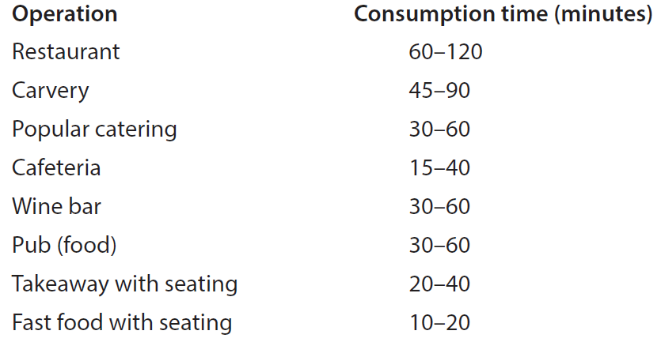
Seating consumption times

Slide 23
Increasing throughput
Reduce the timings for the service sequence
Turn tables
Serve parts of the meal in separate areas
Use brighter lighting and less comfortable seating
Encouraging customers to share tables
Ensure efficient clearing
Utilise new payment solutions
Set minimum charges
Offer reduced menu alternatives

Slide 24
Queue considerations
Fair versus unfair
Comfort verses lack of comfort
Unexplained versus explained
Unexpected versus expected
Unoccupied versus occupied
Initial versus a subsequent wait
Anxious versus calm wait
Individual versus a group waiting
Valuable service versus less valuable service
New or infrequent users versus regular users

Slide 25
Service conventions
Traditional ways of doing things
Have proved to be effective and efficient
Ensure standardisation in the service
Each establishment may be slightly different
But essential that all staff know and follow the same ones

Slide 26
General service conventions
Work hygienically and safely
Always work as part of a team
Pass other members of staff by moving to the right
Use checklists

Slide 27
Booking information
Basic information is the same regardless of how the bookings are taken. This includes:
Day and date
Name of the customer
Customer’s telephone number
Number of covers required
Time of the event – arrival
Special requirements
Signature/record of the person taking the booking in case of any queries

Slide 28
Larger party bookings
For larger party booking there will often be different procedures. This may include:
Set meal and beverages
How billing is to be done
Requirement for a deposit
Seating plan
Deadline for confirmation of final numbers

Slide 29
Preparing for service conventions
Prepare service areas in sequence
Place items consistently
Use trays

Slide 30
Order taking methods
Main methods are:
Triplicate
Duplicate
Service with order
Pre-ordered
All order taking methods are based upon these four basic concepts

Slide 31
Order taking conventions
Take food, wine and drink orders through hosts
Be able to explain food and beverage items
Use order notation techniques
Be aware of customers who may have additional needs
Be open-minded and non-judgemental towards customer differences

Slide 32
Taking or receiving customer orders
Servers can:
Record orders on check pads
Key them in on handheld terminals
Customers can:
Hand write orders
Use electronic systems such as iPads or other touch screens
Use interactive table top projection systems

Slide 33
Essential knowledge
Server must know what they are serving
And, the service requirements
To enable the server to advise the customer on:
the content of dishes
the methods used in making the dishes
the accompaniments offered

Slide 34
Additional requirements
Each establishment will have its own system for indicating:
Identifying which customer is having what item
A follow on order (next course or beverage)
Supplement (additional) order for the same item
Returned food and replacement order
Accident replacement order

Slide 35
General service conventions
Serve cold food before hot food
Serve wine/drinks before food
Avoid stretching across customers
Place items for customer convenience
Start service from the right hand side of the host, with the host last
Serve women first (if convenient for the service but not if a woman is the host)

Slide 36
General service conventions (cont’d)
Silver serve food from the left
Serve plated foods from the right
Serve all beverages from the right
Clear from the right
Separate the tasks of:
serving at table
food/drink collection
sideboard/workstation clearing

Slide 37
Billing methods
Bill as check
Separate bill
Bill with order
Pre-paid
Voucher
No charge
Deferred (charged to account)

Slide 38
Clearing methods
Four main methods:
Manual
Semi-self-clear
Self-clear
Self-clear and strip

Slide 39
Dishwashing methods
Manual
Semi-automatic
Automatic conveyor
Flight conveyor
Deferred wash

Slide 40
Purpose of a revenue control system
Monitors where selling takes place
Activities include:
Efficient control of all food and beverage items issued
Reduction of pilfering and keeping wastage to a minimum
Ensuring bills are correct and proper payment is made and accounted for
Provision of management information

Slide 41
Systems for revenue control
Manual systems
Pre-checking system
Electronic cash registers
Electronic point of sale (EPOS) control systems
Computerised systems
Smartphone app (sometimes referred to as Pin on Glass (PoG)
Satellite stations

Slide 42
Performance measures
Information collected during the revenue control phase includes:
Sales mix
Gross profit
Cost percentages
Seat turnover
Sales per staff member
Sales per seat and sales per area
Formulae and explanations of these performance measures is detailed in Appendix A Food and Beverage Management 5th edition, Cousins et. Al, 2019, Goodfellow Publishers.

Slide 43
Tipping
Tipping for service varies across different cultures, for example:
UK - tipping practice not formalised, with an average of 10-15% added to the bill as ‘discretionary’
USA - normal for customers to add 18%-20% of the total bill
In Japanese dining culture it is seen as impolite to leave a tip
France and Australia tend to include a charge for the service within the listed prices

Slide 44
Tipping in the UK
No legal obligation to pay tips to the staff - some employers do not
Cannot be used to make up an employee’s pay to meet the National Minimum Wage.
UK Government has produced a Code of Best Practice for business owners
‘Tronc’ system often used to manage the way tips are distributed
Tips are taxable

Slide 45
Example malpractices
Dilution of liquor
Short measures
Overcharging of customers
Undercharging of friends
Management pilferage
Kickbacks to managers
Cash registers taken off line
Utilising differentiated gross profit percentages

